Slide 2
Introduction

Slide 3
Motivations
The ensemble learning has been widely used in various kaggle competitions.
Adaptive Structural Network (AdaNet)

Slide 4
Adaptive Structural Network (AdaNet)

Slide 5


Rademacher Complexity

Slide 6
Regularization exploration
r(h_{j}): Rademacher complexity of subnetwork
h_{j}: function of each neuron

Slide 7
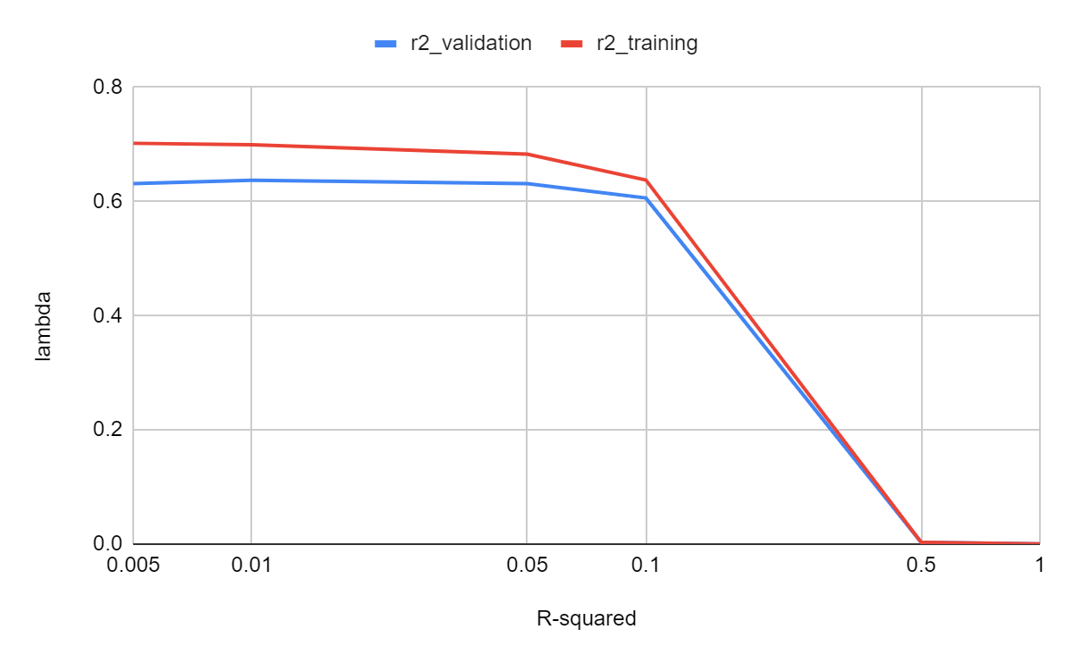
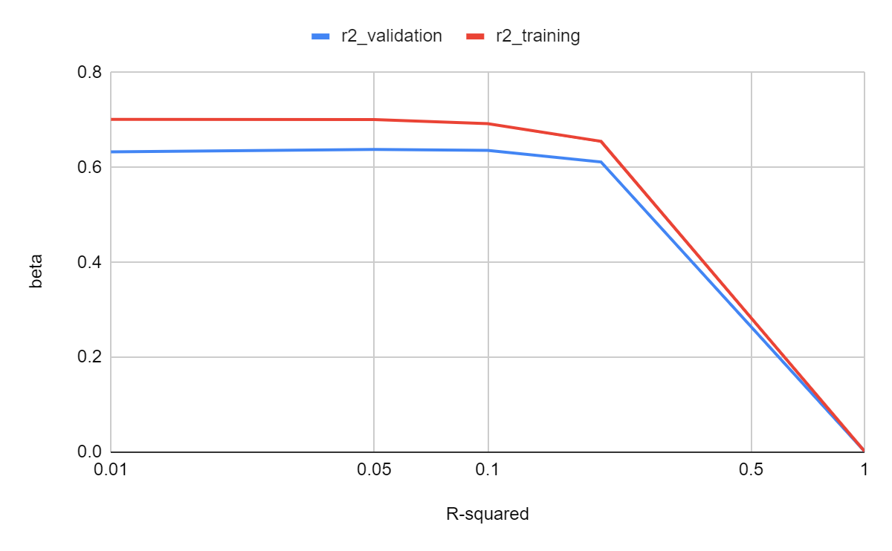
Beta = 0
Lambda = 0

Slide 8
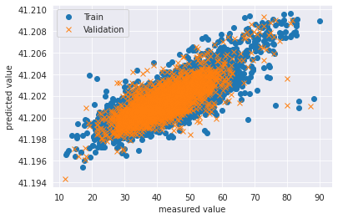
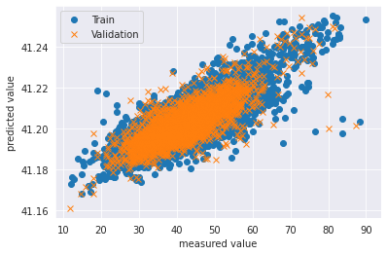
Lambda: 1
Beta: 0
Lambda: 0
Beta: 1
R2_validation: 0.0002
R2_validation: 0.002

Slide 9
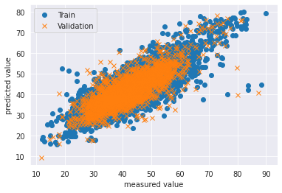

Lambda: 0
Beta: 0
Lambda: 0.01
Beta: 0.05
R2_validation: 0.6311
R2_validation: 0.6395

Slide 10
AdaNet
Generating subnetworks
Grouping strategy
Combining each group of subnetworks (ensembles)
The best ensemble moves onto the next iteration
Evaluating loss of ensembles

Slide 11
AdaNet
Model 1
Candidates Subnetworks:
ANN
ANN(+1 layers)
ANN(+2 layers)
Model 2
Candidates Subnetworks:
ANN
ANN(+1 layers)
ResNet
Comparing subnetworks at each iteration

Slide 12
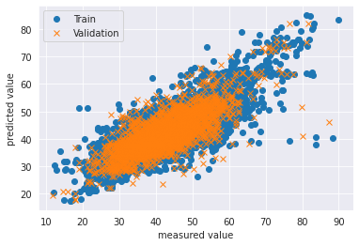
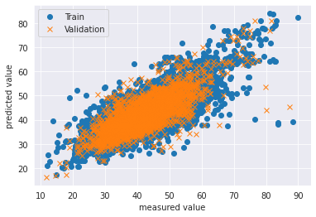
Results
2 ANN + 1 ResNet - 5 iterations
Dataset: combined dataset
3 ANN | Iterations | R2_validation | R2_training
 | 5 | 0.6064 | 0.641
 | 10 | 0.5945 | 0.613
2 ANN + 1 ResNet | Iterations | R2_validation | R2_training
 | 5 | 0.6069 | 0.6427
 | 10 | 0.5944 | 0.6145
 | 10 | 0.5947 | 0.6153
 | 10 | 0.5942 | 0.613
 | 20 | 0.5842 | 0.5924
Normal ANN |  | R2_validation | R2_training
4 layers |  | 0.5968 | 0.6382
6 layers |  | 0.6086 | 0.664
8 layers |  | 0.609 | 0.6746
2 ANN + 1 ResNet - 10 iterations

Slide 13
Results
3 ANN | Iterations | R2_validation | R2_training | subnetworks
 | 5 | 0.6064 | 0.641 | 5 | 6 | 6 | 7 | 9
 | 10 | 0.5945 | 0.613 | 4 | 6 | 6 | 6 | 6 | 6
2 ANN + 1 ResNet | Iterations | R2_validation | R2_training | subnetworks
start from 6 layers | 5 | 0.6069 | 0.6427 | 6a | 6r | 6r | 6r | 6r | 6r
start from 2 layers | 10 | 0.5944 | 0.6145 | 3a | 4a | 5a | 5a | 6a | 6r | 6r | 6r | 6r | 6a
start from 6 layers | 10 | 0.5947 | 0.6153 | 6a | 6r | 6a | 6a | 6a | 6r | 6r | 6r | 6r
start from 6 layers | 10 | 0.5942 | 0.613 | 6a | 6r | 6a | 6r | 6a | 6r | 6r | 7a
start from 6 layers | 20 | 0.5842 | 0.5924 | 6a | 6r | 7a | 7r | 8a | 8a | 9a | 9a | 10a | 10a | 10r | 10r | 10a | 10r | 10r | 10a

Slide 14
Adjust iterations and number of layers of AdaNet

Slide 15
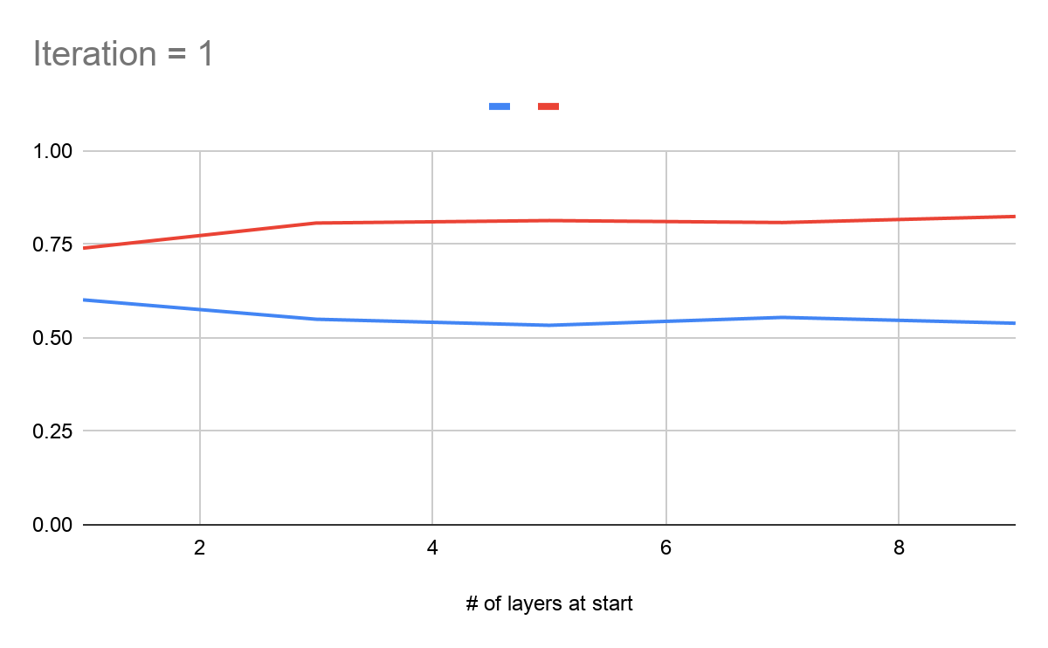
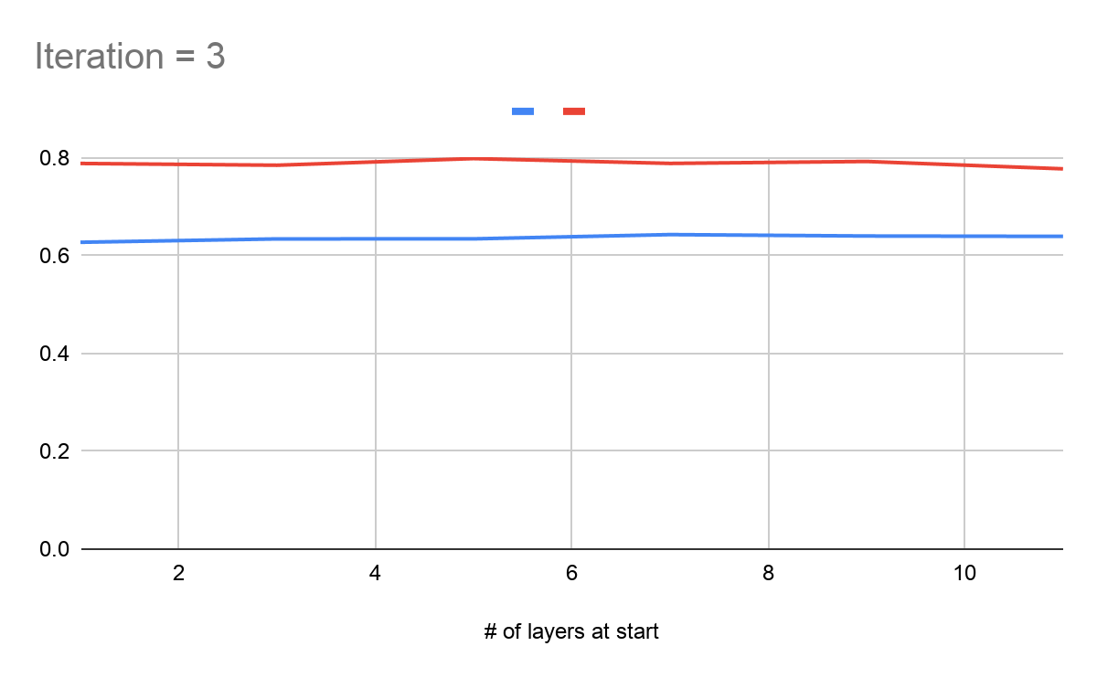
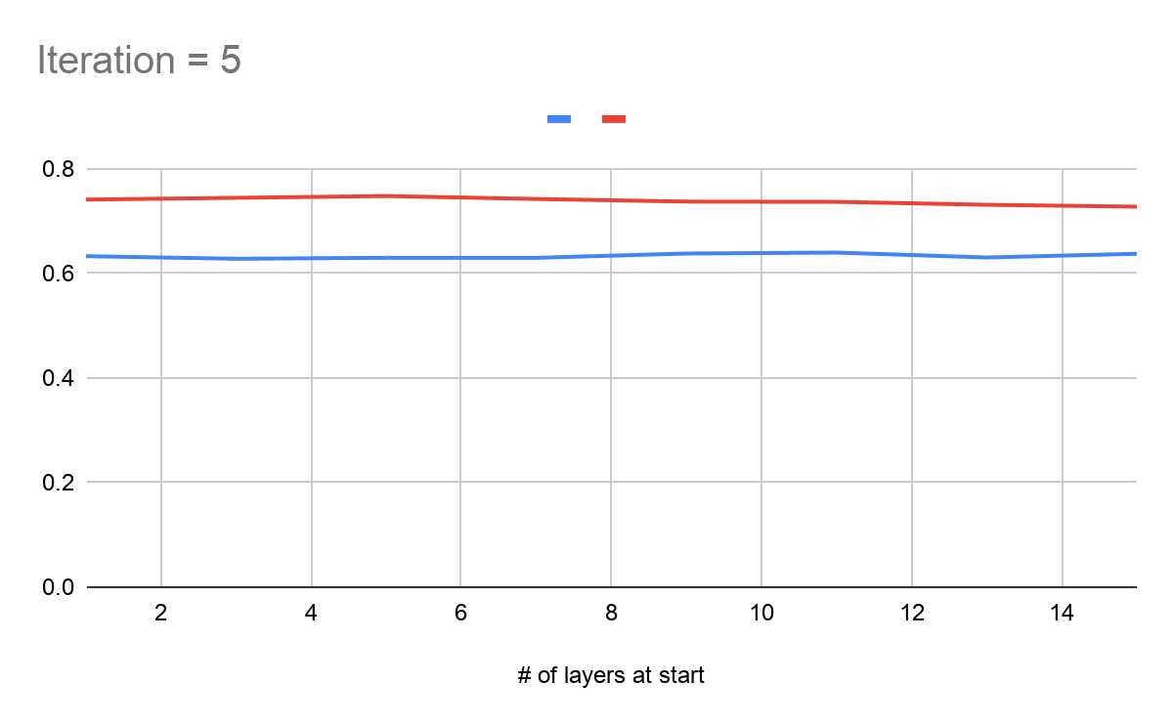
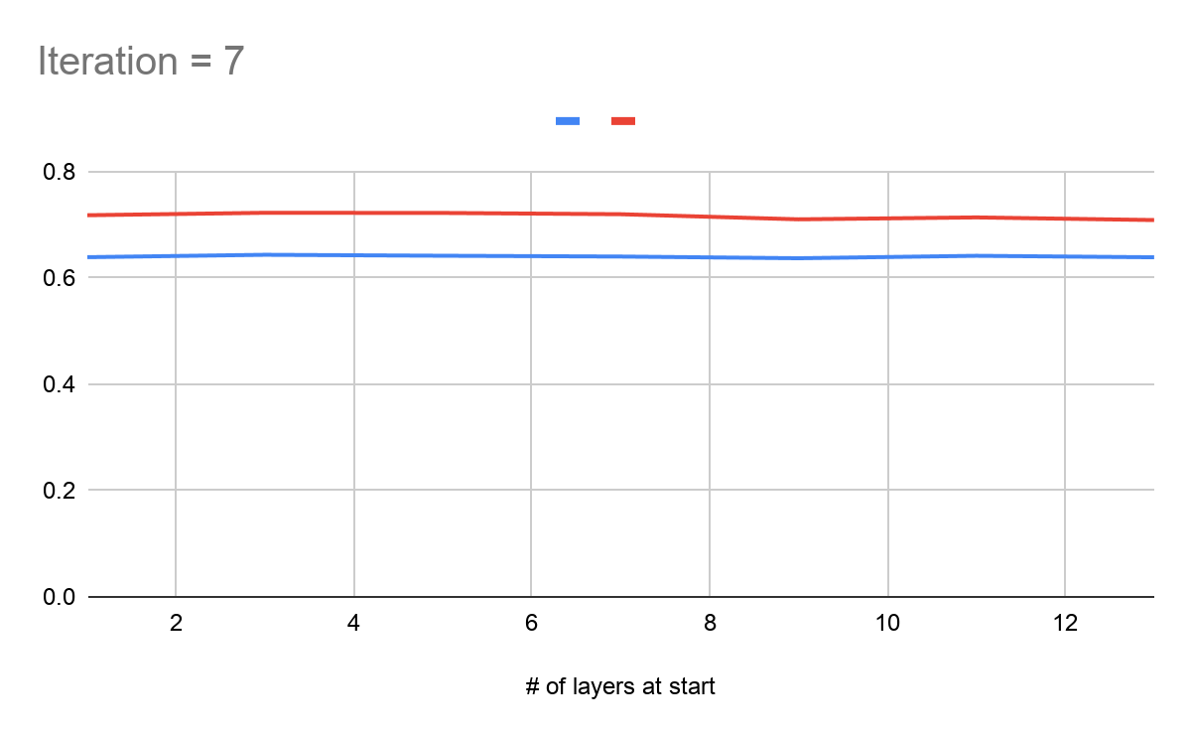
Iterations vs R-squared
Learning rate=0.01
Batch size=32
Layer size = 64
Lambda=0.01
Beta=0.05

Slide 16
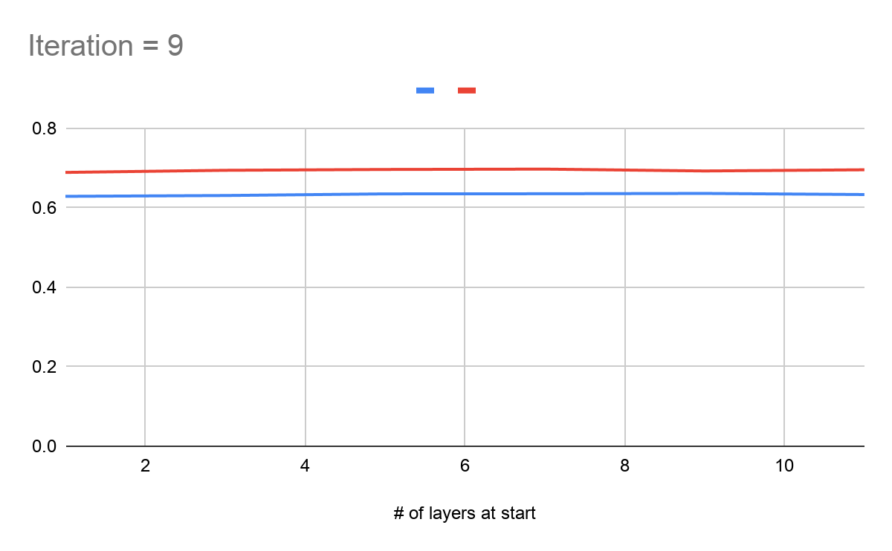
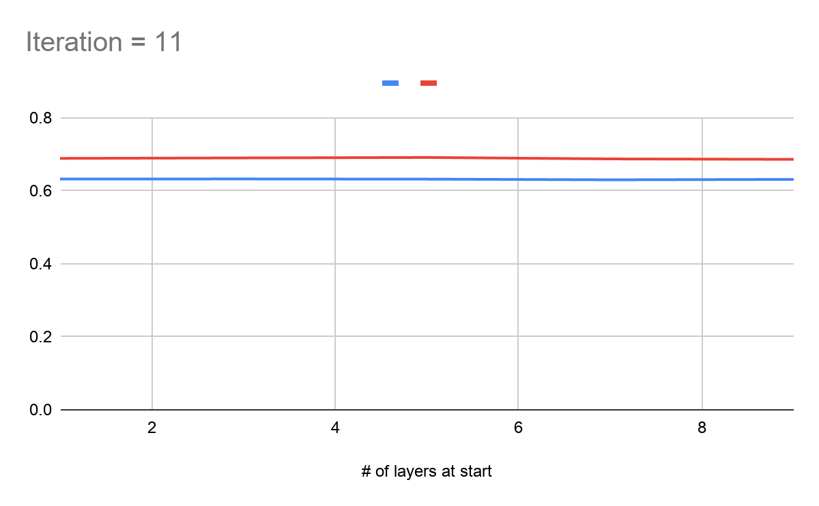
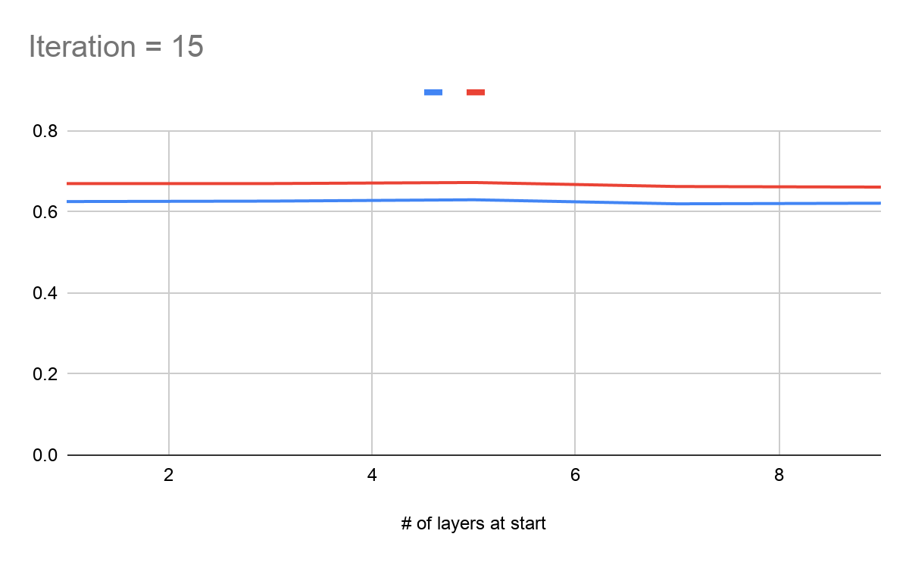
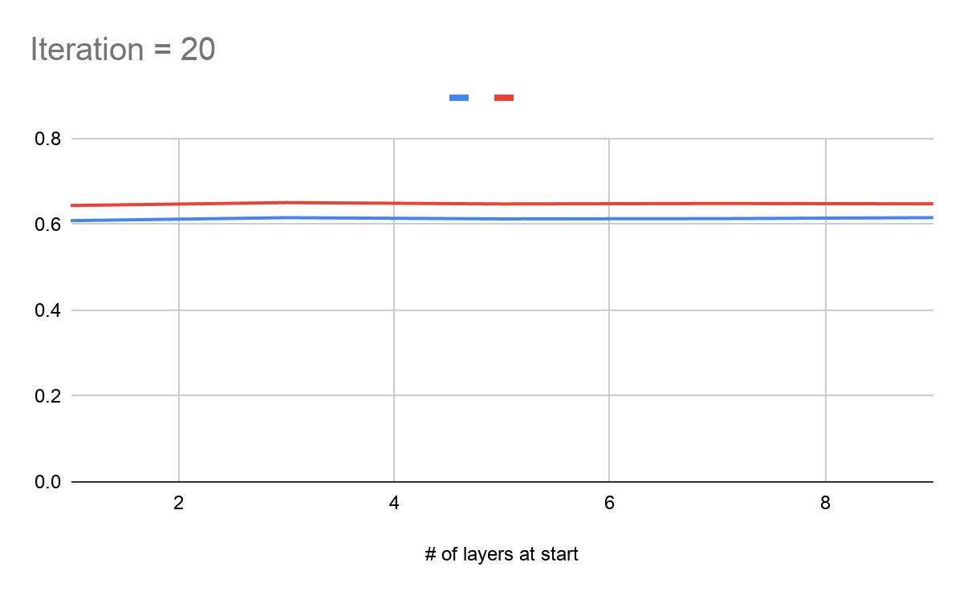
Iterations vs R-squared
Learning rate=0.01
Batch size=32
Layer size = 64
Lambda=0.01
Beta=0.05

Slide 17
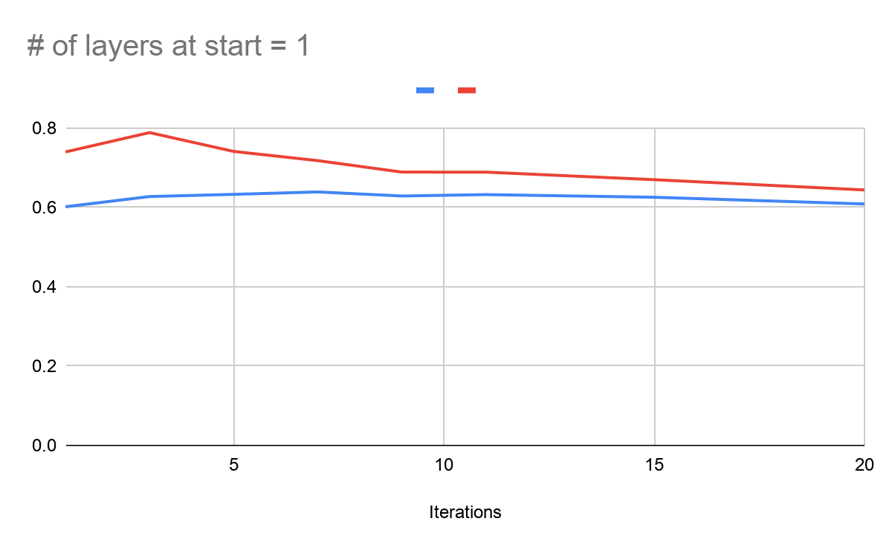
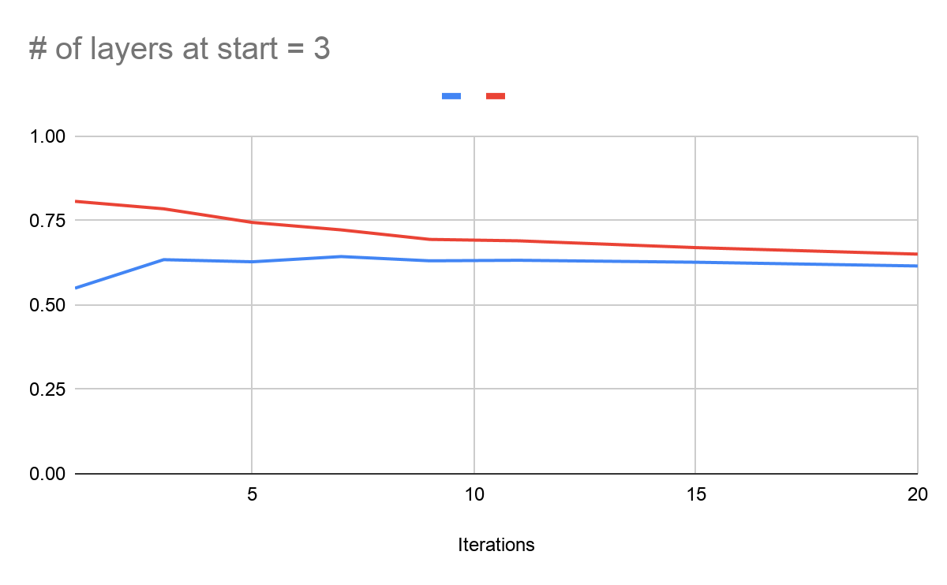
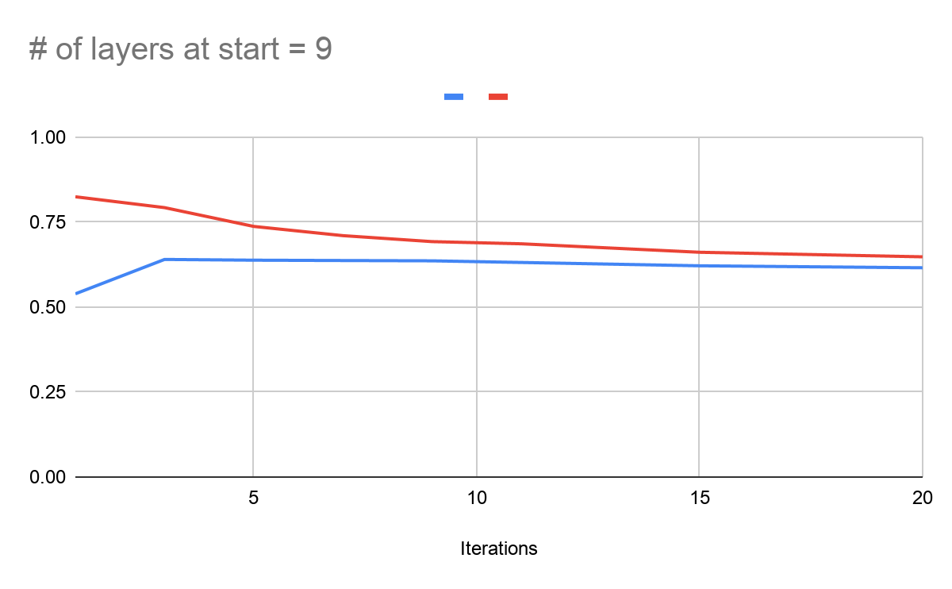
Learning rate=0.01
Batch size=32
Layer size = 64
Lambda=0.01
Beta=0.05

Slide 18
Future works
Retrain saving model with incremental iterations (bug fixing)

